Slide 1
Accurately Predicting Soccer Games In English Premier League
Presenter: Shivam K C
Advised By: Dr. Colby Long
Notes:
Let’s add some picute to the intro slide: EPL logo? Or some players battling? Or aston villa 7-2 Liverpool scoreboard? [Awesome!]

Slide 2

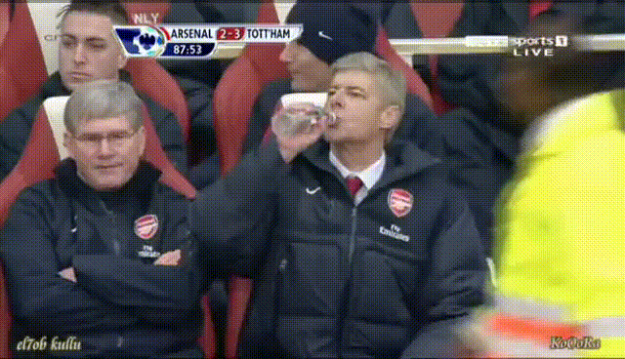
“I get nervous before the games because football (soccer) is not mathematics.”-Arsene Wenger, Former Arsenal’s Manager
Notes:
Add arsene wenger’s pic [you can isnert it} [add arsene wenger’s angry picture!!!] the one with the bottle. “
Sometimes, I feel like the guy in the righ hand side, when my predictions for a soccer game tursn out incorrect! He is Arsene wenger, one of the best managesrs during his time… and he once quoted….

Slide 3


The Ultimate Outcome of My IS
Build a mathematical model…
To predict English Premier League (EPL) soccer games…
Better than the bookmakers and the expert tipsters…
That is with at least 68% accuracy [1].
Notes:
Well, that doesn’t stop me stop me from using mathematics to accurately predict soccergames. Infact it motivates me…[sould I talk about my dad’s quote? Probably at the end!]…in fact, the goal of my IS is:
Add some picture like that at the end!...garry kasparov being beaten?

Slide 4
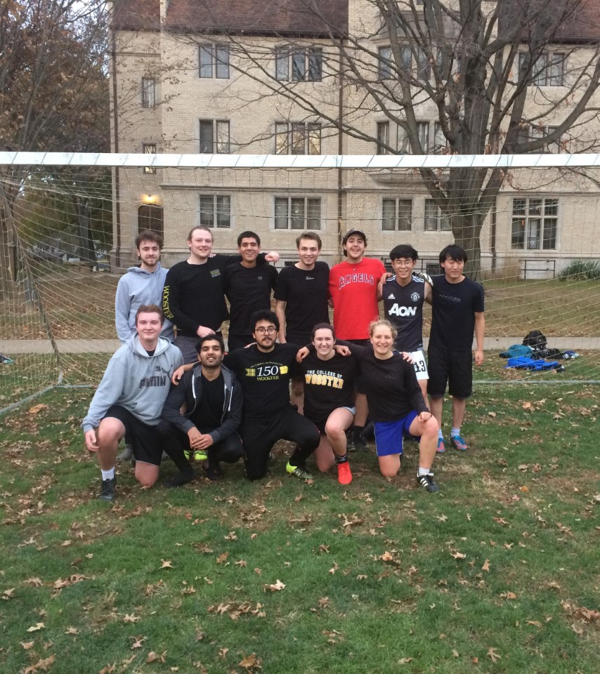
Purpose for My IS
I LOVE SOCCER!!!!
A gut instinct: While applying to the College of Wooster and learning about the IS, I told myself that I will predict soccer games for my IS.
Notes:
I could talk about or joke about playing against Dr. Long. On our way to winning the intramuralt competition. [put the picture in the slide!]
I could talk about the biases and chipping away after presenting the work I have done so far??

Slide 5
Methodology 1: Machine Learning Algorithm (MLA)
Data: Seasons 2006/2007 to 2017/2018
Response Variable: Probabilistic Outcomes (W/L/D)
Predictors: 30+ factors such as interceptions, shots at crossbar, expected goals, etc.
Baseline Model: Bookmaker’s odds converted to probabilities.
MLA: Ordinal Logistic Regression, ANN, Random Forest, and Stochastic Modelling
Notes:
This is it!!!
Explore the poisibel of GA?

Slide 6

Ordinal Logistic Regression
It is used to model the relationship between a set of predictors and an ordinal response
Poor/Fair/Excellent or Win/loss/draw
An extension of the logistic regression model that applies to dichotomous dependent variables, allowing for more than two (ordered) response variables.

Slide 7
Methodology 2: KKC Model
Data: Last 3 Fantasy Premier League (FPL) seasons.*
Response Variable: Match Outcomes (W/L/D)
Predictors: Fixtures difficulty, Player’s cost, ICT index*
Baseline Model: Bookmaker’s odds converted to match outcomes.
“Simplicity is the key!”
Notes:
Basic idea is that simple mdel will outperform compliated models
Fantasy Premier League is a game that casts you in the role of a Fantasy manager. You are given the task to pick a squad of real-life players who score points for your team based on their performances in their own matches.
Higher odds for team means the team loses….!! Lower odds for draw means a draw!!!

Slide 8
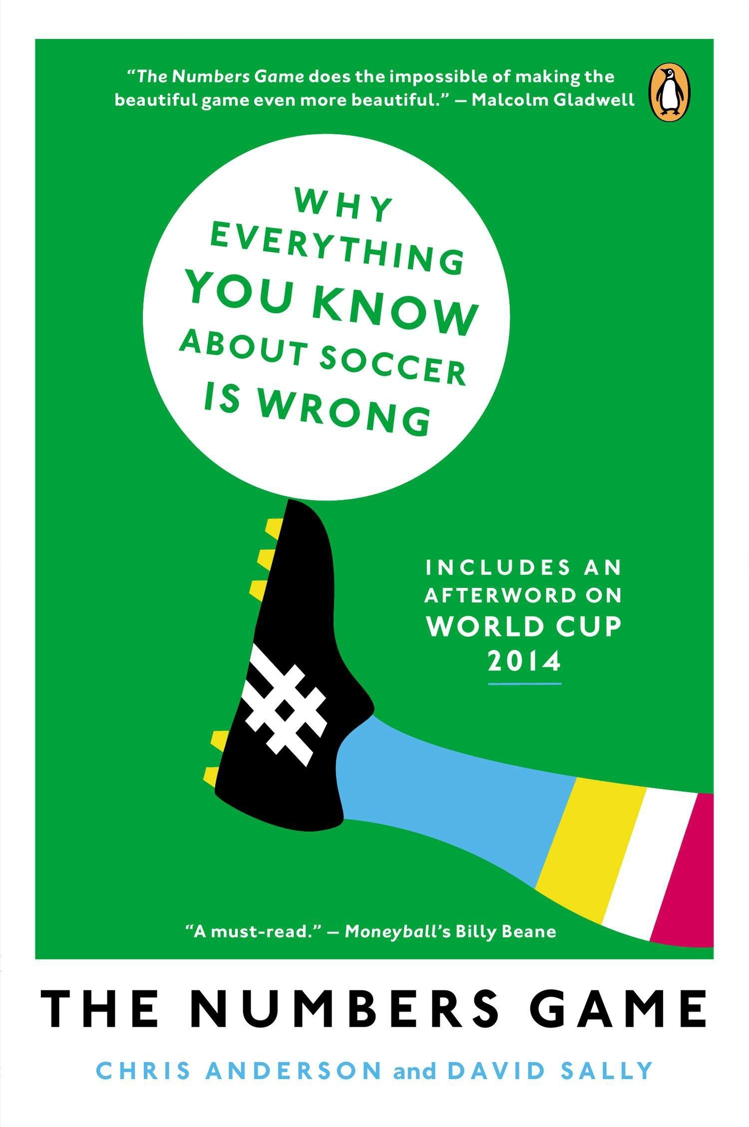
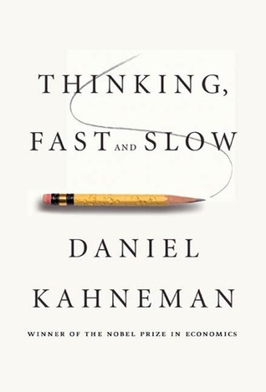
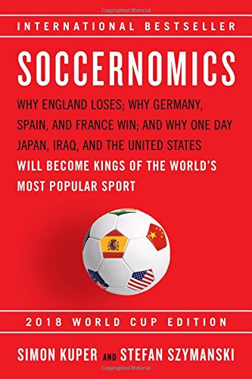
Work Done So Far
Literature Review
Data cleaning
Attended the Carnegie Mellon Sports Analytics Conference!
Notes:
[got some good ideas….specially regarding modelling! And the methodology for my IS]: specifically, the team news data to build models!

Slide 9

Next Steps
Build Models
Compare predictive accuracy
Eventually, the process will enable me to get the best model to predict the outcomes of EPL games.
Only possible by stepping on the shoulders of the giants from numerous fields such as mathematics, statistics, data science, psychology, economics, poker, decision making, and AI.

Slide 10
Work Citation
[1] Rory P. Bunker and Fadi Thabtah. A machine learning framework for sport result prediction. Applied Computing and Informatics, 15(1):27 – 33, 2019.

